Slide 1
Computer Vision – Module 4
Dr. Sreejith Rajan

Slide 2
Image Segmentation
Image Segmentation
│
├── Region-Based
│ ├── Region Growing
│ ├── Splitting
│ ├── Merging
│ ├── Split & Merge
│ └── Thresholding
└── Edge-Based
├── Gradient Methods
├── Second-Order Methods
├── Canny
├── Edge Linking
└── Active Contours

Slide 3
Region Growing
Start from a seed pixel and grow the region by adding neighboring pixels that are similar.
Steps
Choose seed(s)
Define similarity criterion
Check neighbors
Add similar pixels
Repeat until no change
✅ Key Point
Works like “flood fill”

Slide 4
Region Splitting
Concept
Start with the whole image → divide into smaller regions until each is homogeneous.
Method
Uses quadtree decomposition
Split if the region fails the uniformity test
Key Point
Top-down approach
Limitation
May produce blocky regions

Slide 5
Region merging
Concept
Start with small regions → merge similar neighboring regions
Condition
Merge if similarity condition satisfied
Key Point
Bottom-up approach
Limitation
Risk of incorrect merging

Slide 6
Split and Merge
Combination of:
Splitting (divide non-uniform regions)
Merging (combine similar regions)
Key Point
Balances both approaches
More accurate than using either alone

Slide 7
Thresholding

Slide 8

Edge Based Methods – Gradient method
Concept : Use first derivative to detect edges
Operators
Sobel
Prewitt
Roberts
Formula
$$∇I=\sqrt{G_{x}^{2}+G_{y}^{2}}$$
Key Point
Simple and fast

Slide 9
Second-Order Methods
Concept: Use the second derivative of intensity
Methods
Laplacian
LoG (Laplacian of Gaussian)
Detection
Edges at zero-crossings
Key Point
Detects fine details
Limitation
Very sensitive to noise

Slide 10
Canny Edge detection
Concept: Multi-stage, optimal edge detector
Steps
Noise reduction
Gradient calculation
Non-max suppression
Double thresholding
Edge tracking
Key Point
Best trade-off between noise & accuracy

Slide 11
Edge Linking/Contour detection
Concept :Convert detected edges into continuous boundaries
Methods
Hough Transform
Contour tracing
Graph-based linking
Key Point
Helps form complete objects

Slide 12
Active Contours(Snakes)
Concept: A curve evolves to fit object boundary by minimizing energy
Energy Components
Internal (smoothness)
External (image forces)
Key Point
Flexible and accurate for complex shapes
Limitation
Needs good initialisation

Slide 13
Graph Cut (Energy Minimization Segmentation)
Convert image into a graph and cut it optimally
Imagine:
Every pixel is a node
Similar pixels are strongly connected
Different pixels are weakly connected
Now:
If you “cut” the weakest connections
The image splits into regions

Slide 14
Graph Representation
Nodes
Each pixel = node
Plus two special nodes:
Source (S) → foreground
Sink (T) → background
N-links (Neighbor links)
Between pixels
Strong if similar
Weak if different
T-links (Terminal links)
Pixel → Source / Sink
Probability of being foreground/background

Slide 15
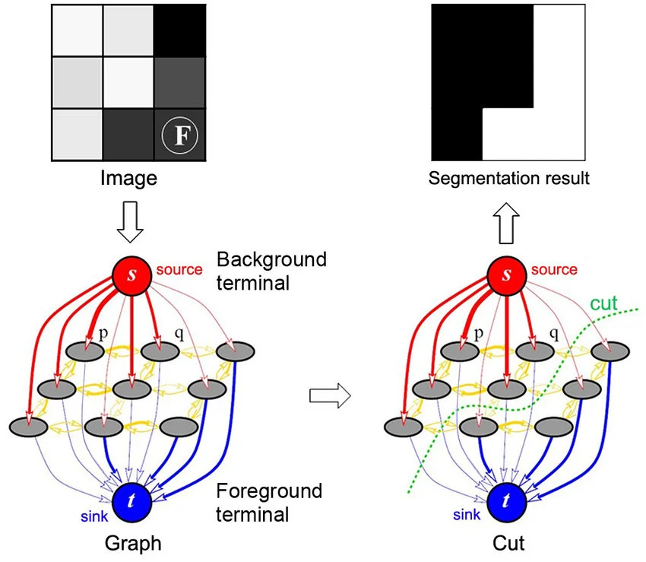
WHAT IS A “CUT”?
A cut divides graph into:
Foreground group
Background group

Slide 16
Steps
Step 1: Assign probabilities
Each pixel:
Likely foreground
Likely background
Step 2: Build graph
Add nodes
Add edges with weights

Slide 17
Step 3: Apply Min-Cut / Max-Flow
Algorithm finds optimal cut
Step 4: Result
Pixels connected to Source → Foreground
Pixels connected to Sink → Background

Slide 18
Mean Shift Segmentation
Mean Shift is a clustering algorithm that finds dense regions (clusters) in data by iteratively shifting points toward the average (mean) of nearby points.’
Place a window (circle/sphere) over data points
Compute the mean of points inside the window
Move the window to that mean
Repeat until it stops moving

Slide 19
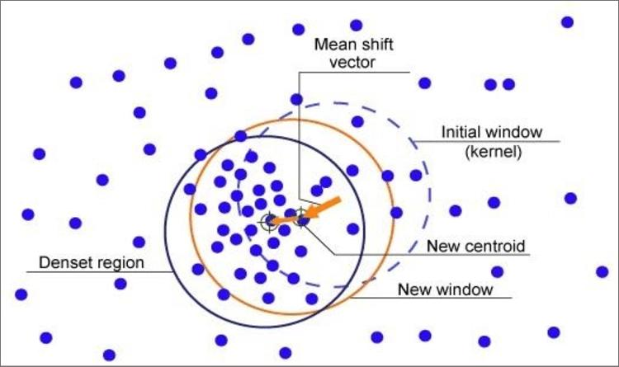

Slide 20
Algorithm
Pick a point x
Define a window (bandwidth h)
Compute mean of points inside window
Shift point to mean
Repeat until convergence
Points converging to same location → same cluster

Slide 21
MRFS
A Markov Random Field (MRF) is a model that says: “A pixel’s label depends on its neighbors.”
In images:
Pixels are not independent
Nearby pixels usually belong to the same region/object

Slide 22
Intuition
Think of an image like a grid:
Each pixel = a node
Neighboring pixels = connected
Labels = object classes (background, cell, edge, etc.)
If most neighbors are “cell”, this pixel is likely also “cell”

Slide 23
Start with initial labels(from thresholding / Mean Shift)
Define neighborhood system(4-neighbor or 8-neighbor)
Compute energy
Update labels to reduce energy
Repeat until stable

Slide 24
Advantages
✅ Removes noise
✅ Enforces spatial consistency
✅ Produces smooth regions
✅ Works well with segmentation outputs

Slide 25
Texture Segmentation
Texture segmentation means dividing an image into regions based on repeating patterns, not just color.
Why Texture Matters
Two regions may have:
Same color
Different texture
✅Example: Grass vs green cloth

Slide 26
How Texture is represented
Texture is described using features:
1. Statistical Features
Mean, variance
Gray-Level Co-occurrence Matrix (GLCM)
👉 Captures intensity relationships
2. Filter-Based Features
Gabor filters
Wavelets
👉 Detect patterns at different scales & orientations

Slide 27
3. Local Binary Patterns (LBP)
Encodes local neighborhood structure
👉 Very popular for:
Face recognition
Medical imaging

Slide 28
Texture segmentation pipeline
Input Image
Apply texture operators (Gabor / LBP / GLCM)
Generate feature map
Cluster pixels (K-means / Mean Shift)
Label regions

Slide 29
Advantages
✅ Works when color fails
✅ Captures structural information
✅ Powerful for medical images

Slide 30
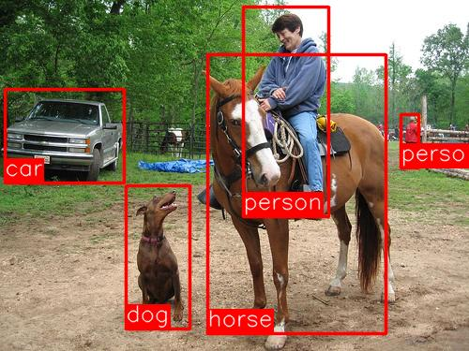
Object Detection
Object Detection is the task of: Finding objects + identifying what they are + locating them
So for each object, we get:
Bounding box (location)
Label (what it is)
Confidence score

Slide 31
Difference from Classification
Classification → “What is in the image?”
Detection → “What is in the image AND where?”

Slide 32
Pipeline
Input image
Detect regions of interest
Extract features
Classify each region
Draw bounding boxes

